Slide 1
Core Spring

Slide 2
Spring Framework
Spring is a light weight, Inversion of Control and Aspect Oriented container framework

Slide 3
Spring Module
The Spring framework comprises of many modules such as core, beans, context, expression language, AOP, Aspects, Instrumentation, JDBC, ORM, OXM, JMS, Transaction, Web, Servlet, Struts etc. These modules are grouped into Test, Core Container, AOP, Aspects, Instrumentation, Data Access / Integration, Web (MVC / Remoting) as displayed in the following diagram.

Slide 4
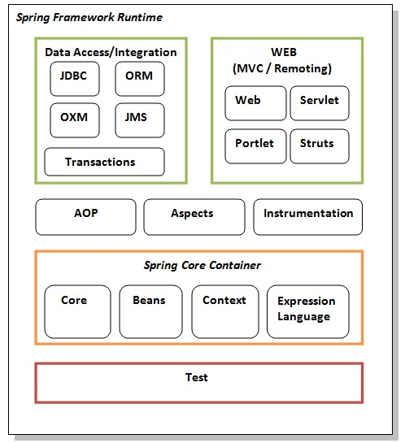
Remoting) as displayed in the following diagram.

Slide 5
IOC(Inversion of Control) Container/Spring Container
The basic concept of the IOC container is that we don’t create our objects but describe that how they should be created. Somehow ,IOC container is responsible to create the object known as bean.
The IOC container enforces the dependency injection to leave the classes loosely coupled .
The IOC container get informations from the XML file and work accordingly.

Slide 6
Dependency Injection
Dependency Injection is a design pattern that removes the dependency from the programming code so that it can be easy to manage and test the application.
Dependency Injection makes our programming code loosely coupled .In this case we provide the information from the external source such as “XML” file .

Slide 7
Dependency Injection can be done in three ways
Using Constructor Injection
Using Setter Injection
Interface Injection

Slide 8
Bean
The object that form the backbone of our application and that are managed by the Spring IOC container are called Beans.
Spring IOC container are called beans . A bean is an object that is instantiated ,assembled and managed by a Spring IOC container .
These beans are created with the configuration metadata(which is represented by XML,Java, annotations, Java Code) that you can supply to the container.
Bean definition contains the information called configuration metadata, which is needed for the container to know thw following-
How to create a bean
Bean’s Lifecycle details
Bean’s dependency

Slide 9
Ways to implement the life cycle of the Bean
There are 3 ways to implement the life cycle of the Bean.
By XML
By Interface
By Annotation

Slide 10
Autowiring
It is a feature of Spring Framework in which Spring Container inject the dependencies automatically.
Autowiring can’t be used to inject primitive and string values.It works with reference only.

Slide 11
Implementing Autowiring can be done in 2 ways
Using XML
byName
byType
Constructor
Autodetect
Using Annotations
@Autowired

Slide 12
Standalone collection
Here we will use collection datatype (List ,Set ,Map ,Properties) for the dependency injection
After creating the datatype with this concepts we can use it for several time in our program.
Standalone Collection
-Standalone LinkedList
-Standalone Vector
-Standalone Map
-Standalone Properties

Slide 13
Stereotype Annotations
@Component
@Values
@Scope – like– Singleton, Prototype, request , session and global session

Slide 14
Spring Expression Language
It supports parsing and executing expression with the help of @Value annotation
Syntaxes →
@Value(“#{expression}”)
@ Value(“#{T(class).method(parameter)}”)
@ Value(“#{T(java.lang.Math).sqrt(no.)}”)

Slide 15
Thankyou

